Slide 1
Patient Monitoring and Control System using Internet of Thing
Submitted by Group 2- Mohpreet Sidhu(C0749072)

Slide 2
Hardware
Beaglebone Black
TP Link
Temperature Sensor(DS18B20)
Heart Rate Sensor(AD8232)
Blood Pressure Monitor
GSM Module (SIM900)

Slide 3
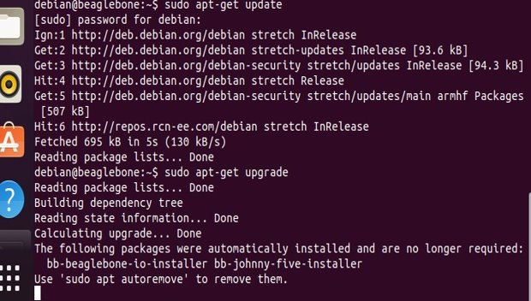
Beaglebone Black
To login command used :-
[ sudo ssh 192.168.7.2 -l debian ]
To check version :-
[uname –a]
To update :-
[ sudo apt –get update ]
To upgrade :-
[sudo apt –get upgrade]

Slide 4
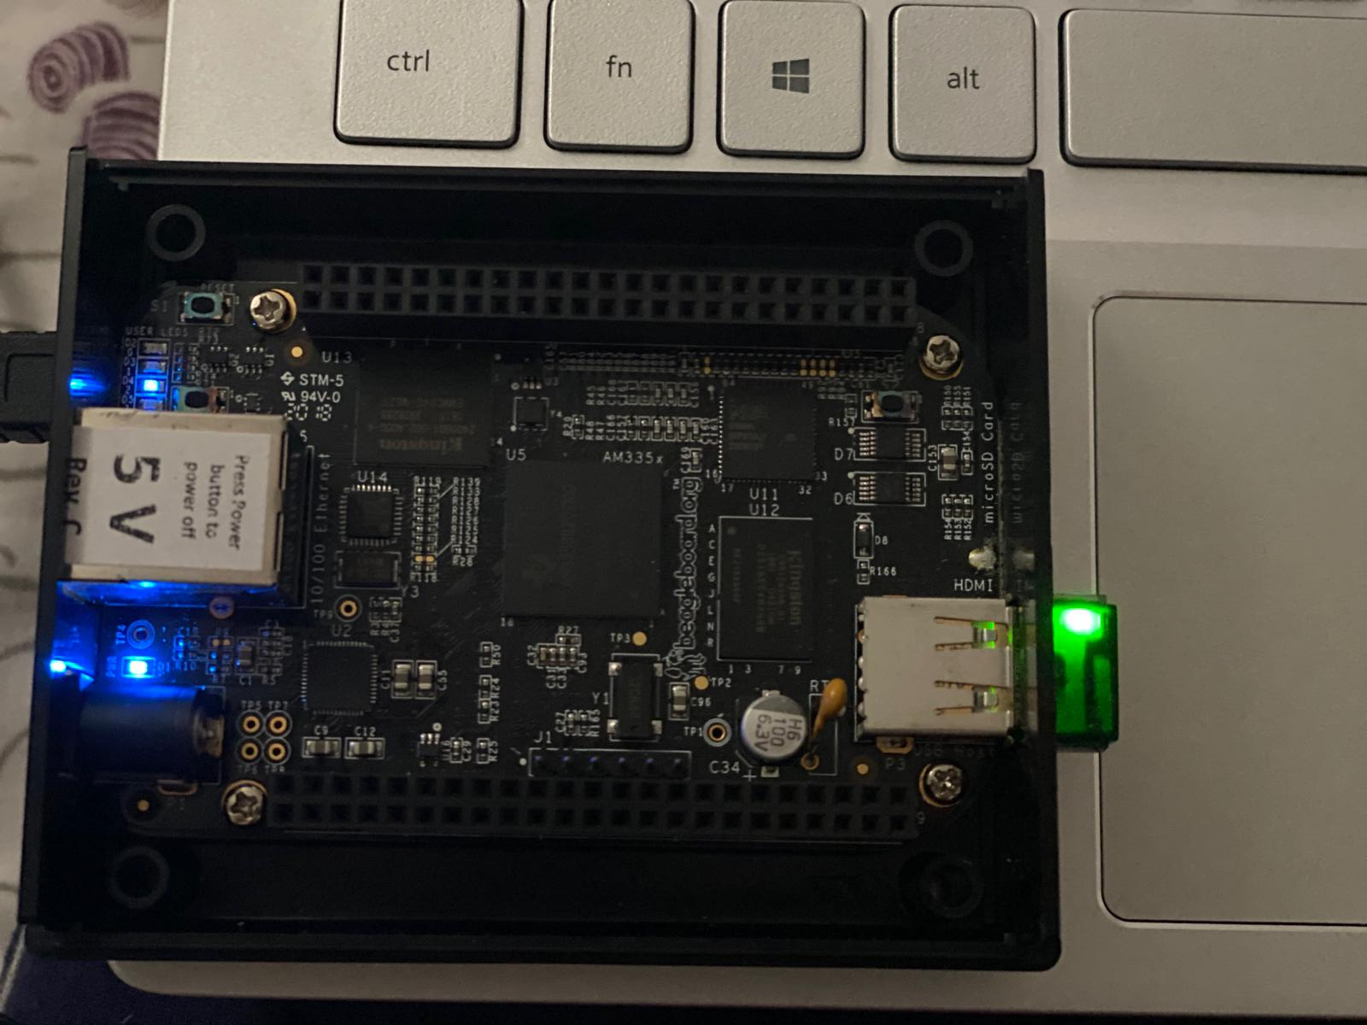
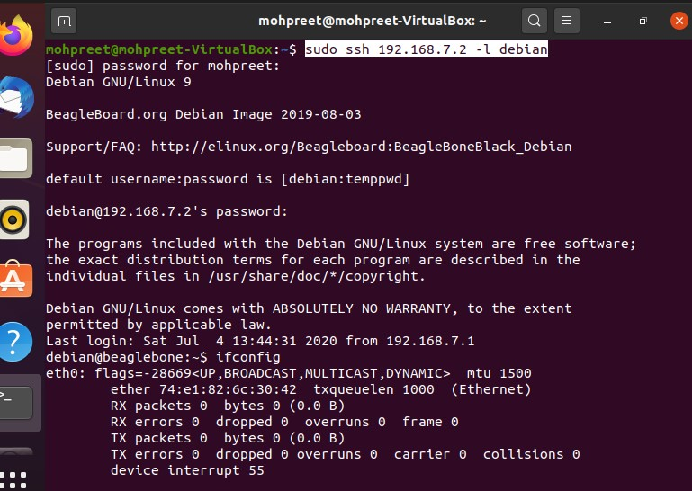
TP Link
TP link connected via Beaglebone Black.
1.

Slide 5
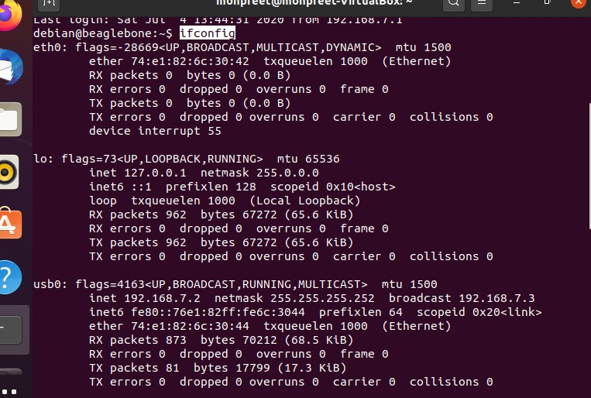
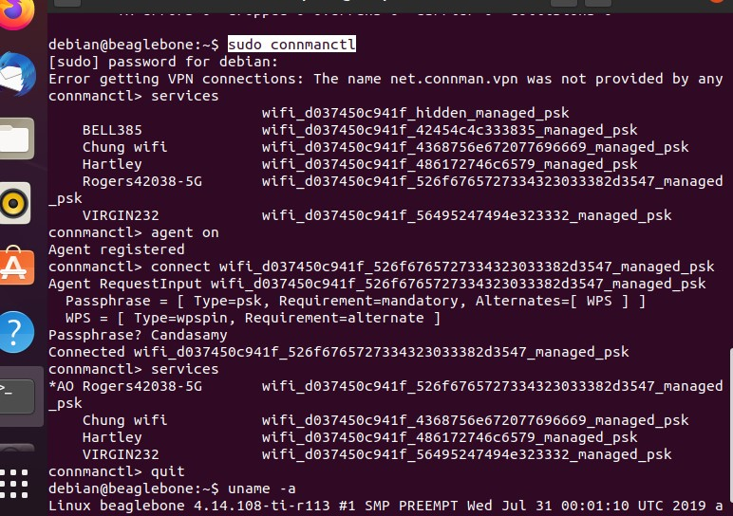
2.
3.

Slide 6
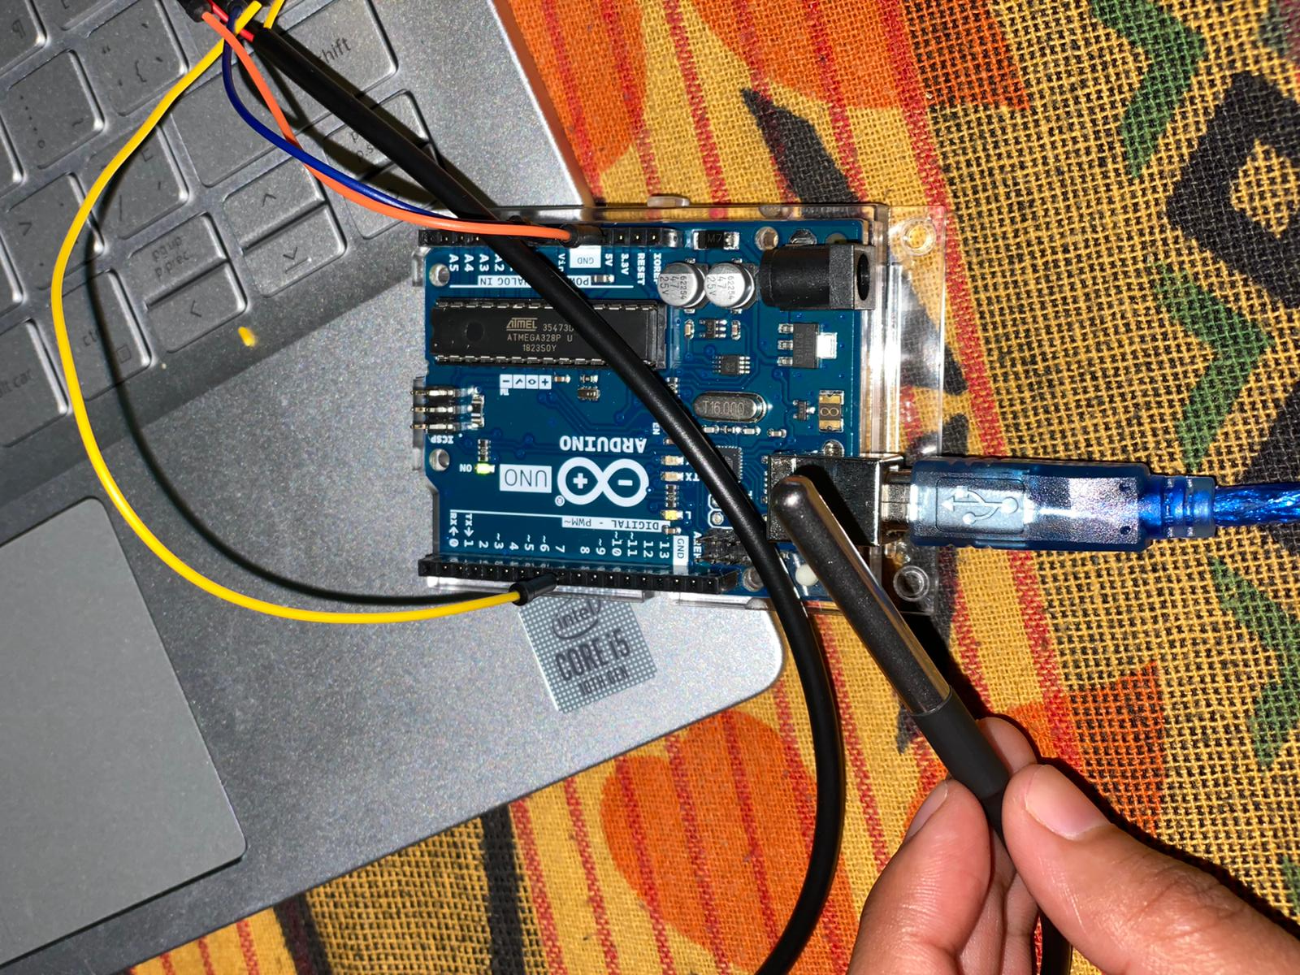
Temperature Sensor(DS18B20)
Black wire(GND) to GND (Arduino)
Yellow wire(DATA) to Pin 5(Digital side)
Red wire (VCC) to 3.3v(Arduino)

Slide 7
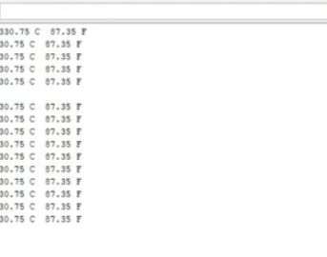
Result

Slide 8
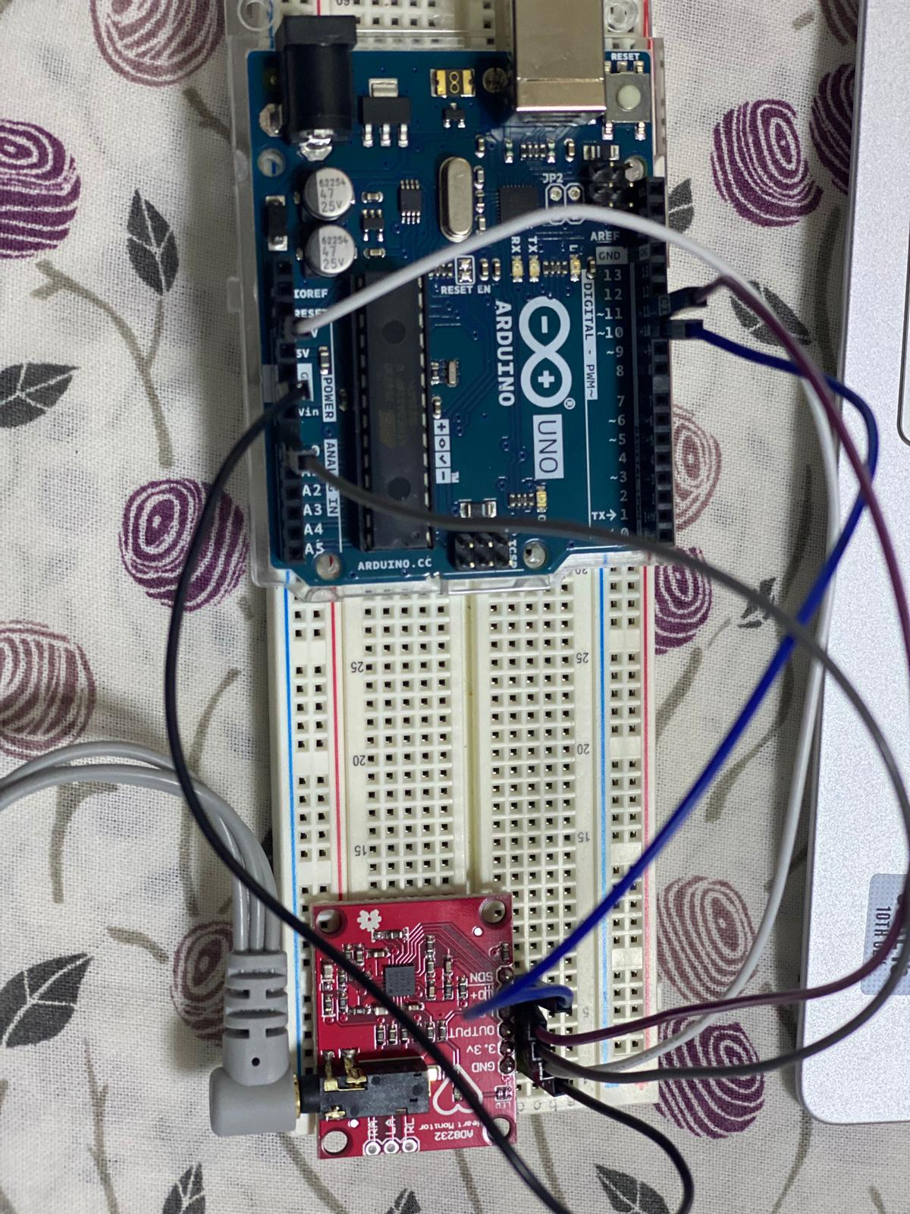
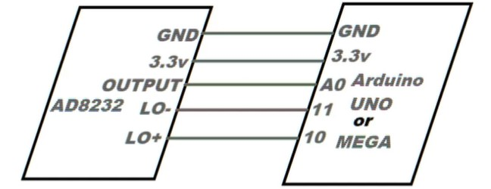
Heart Rate Sensor(AD8232)
Connection

Slide 9
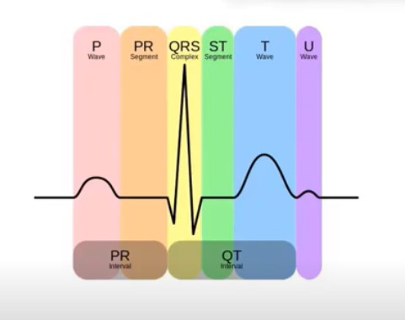
ECG is short for electrocardiogram. It is used to record the electrical activity of the heart from different angles to identify and locate pathology. Electrodes are placed on different parts of a patient's limbs and chest to record the electrical activity.

Slide 10
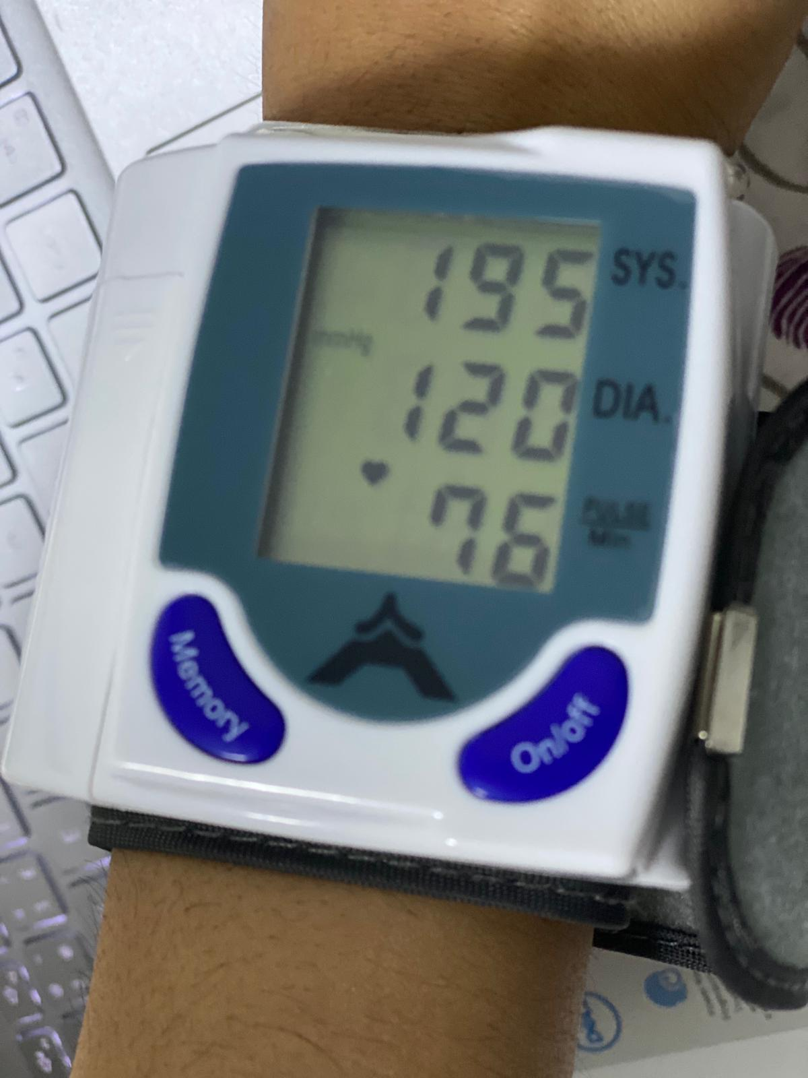
Blood Pressure Sensor
The blood pressure sensor is tested using 5 V battery cell and the reading are shown on the LCD screen.
This is an arterial blood pressure sensor which has automatic inflation and deflation

Slide 11
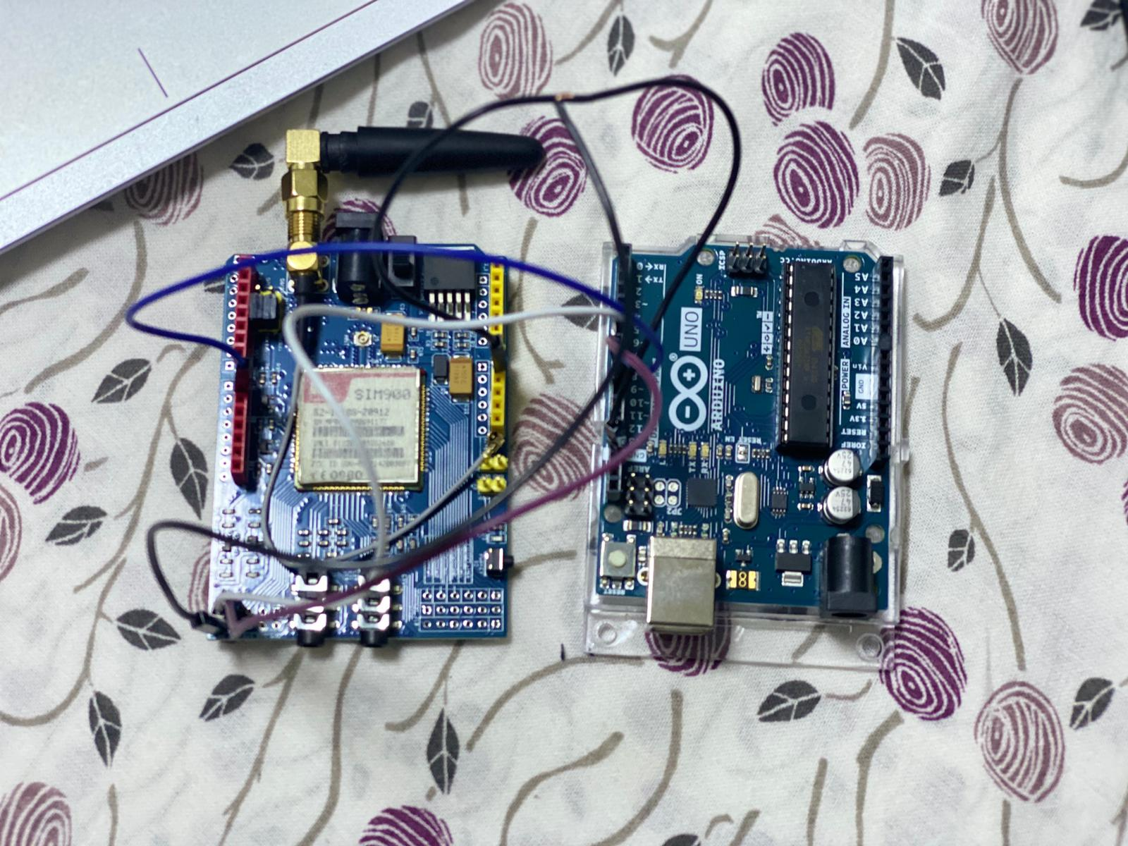
GSM Module (SIM900)
Black Wire(GND) at UART side is connected to GND(Digital side ) on Arduino.
Purple Wire(TXD) at UART side is connected to pin 7 (Digital side) on Arduino.
White Wire(RXD) at UART side is connected to pin 8 (Digital side) on Arduino.
Connect D9 on the shield to the D9 Arduino pin .

Slide 12
References
Exploring Beaglebone Book (Second Edition)2019 by Derek Molloy.
DVP Technology (DS18B20) -- September 2018
https://www.youtube.com/watch?v=lIpgGru2Wv0&t=65s
DVP Technology(AD8232) -- September 2018
https://www.youtube.com/watch?v=xySBTU_9vGo
RANDOM NERD TUTORIALS, (N.D), Guide to SIM900 GSM GPRS Shield with Arduino
https://randomnerdtutorials.com/sim900-gsm-gprs-shield-arduino/

